Slide 1



EchoLearn
PRESENTED BY CORE

Slide 2



Core members
Lerah A. Caones
Danielle Maxine P. Ocampo
Christy Roan N. Reroma

Slide 3

Pain point
1.
Information Overload: Struggling to keep up with schoolwork.
2.
Time Management: Lack of assistance in organizing tasks.
3.
Communication Gap: Weak connection between learners and educators.

Slide 4

Solution
Goal: A student-centered online education platform.
Focus:
Enhancing the student-teacher workforce.
Creating a dynamic learning environment.
Ensuring harmonious rapport.

Slide 5

Prioritization System: Organizes assignments by difficulty, estimated time, and deadlines.
Description
of solution
1.
Integrated Planner & Calendar: Auto-imports assignments and syncs with the prioritization system to prevent missed deadlines.
2.
Side Chat & Split Screen: Create focused sub-chats within group conversations to keep information organized without clutter.
3.

Slide 6
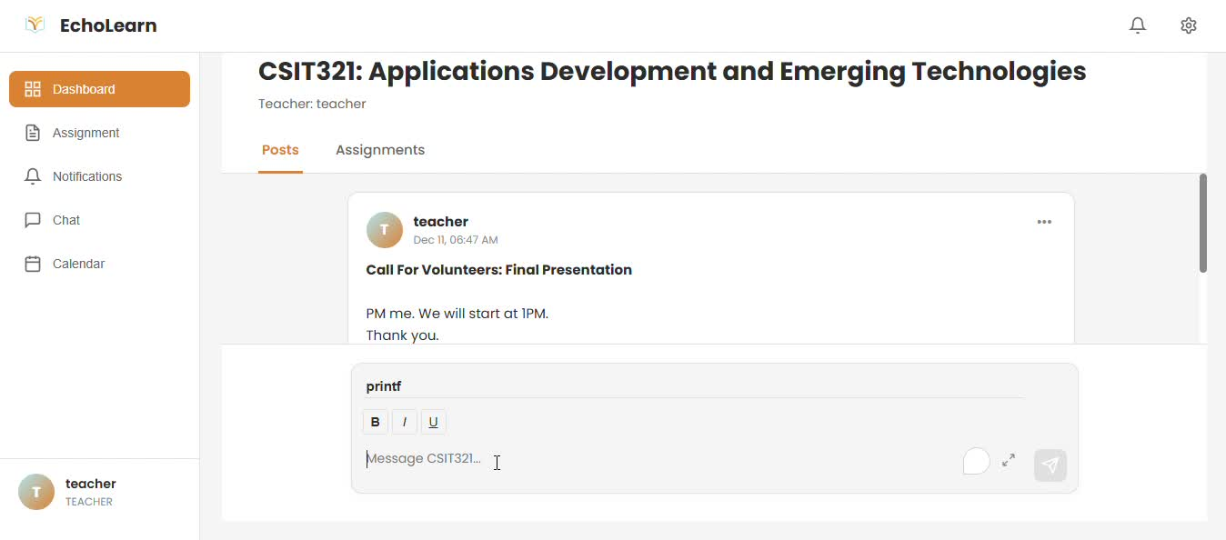
Core features
class dashboard

Slide 7
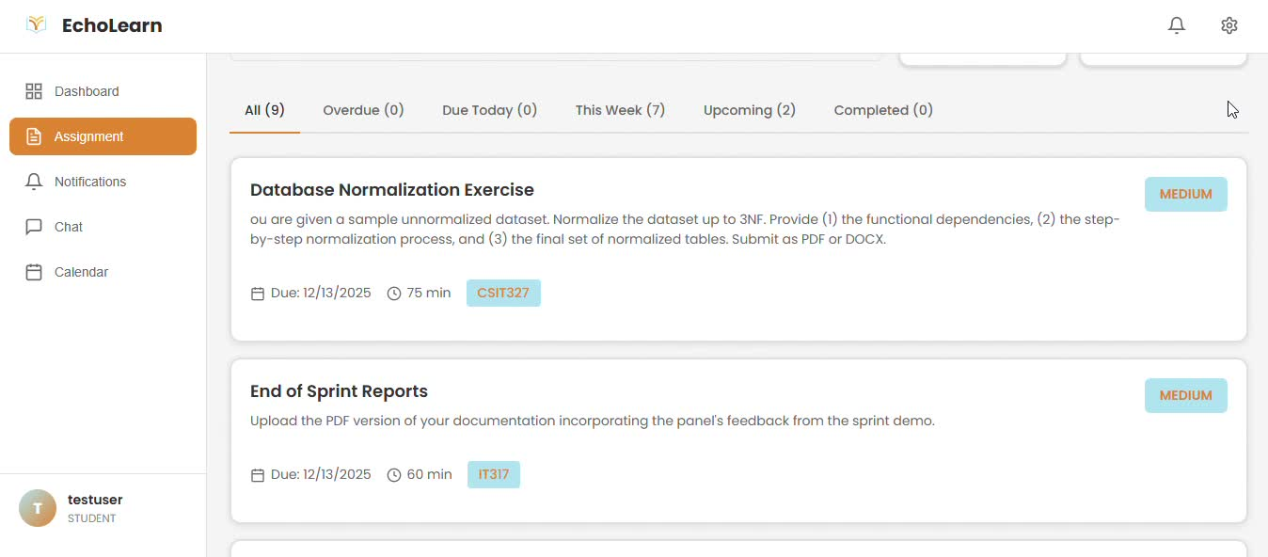
Core features
Prioritization System

Slide 8
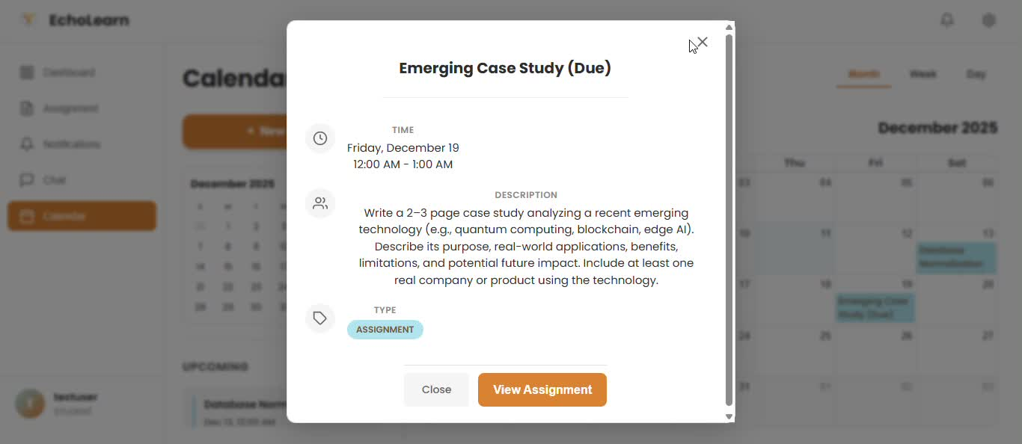
Core features
Integrated Planner & Calendar

Slide 9
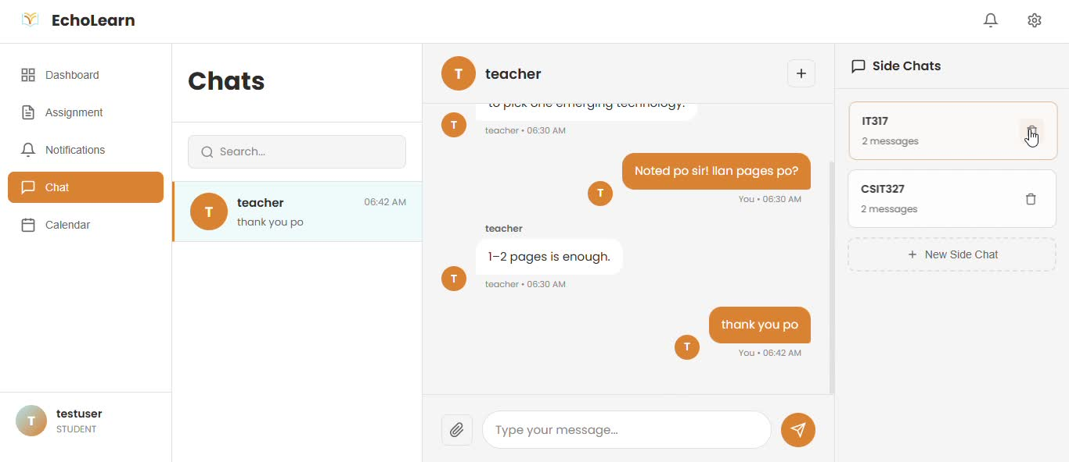
Core features
Side Chats

Slide 10
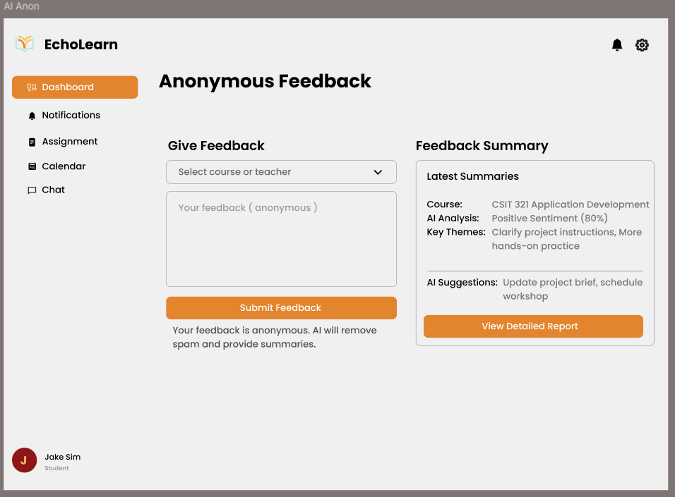
AI Component
Encourage Honest Dialogue: Allows students to share concerns and feedback completely anonymously, removing the fear of judgment.
Intelligent Spam Filtering: Our AI automatically detects and hides spam, trolls, or irrelevant content, ensuring only constructive feedback reaches the instructor.
Instant Summarization: Instead of reading through hundreds of raw messages, the AI synthesizes responses into clear, digestible summaries.
Actionable Suggestions: The system analyzes feedback sentiment and automatically proposes concrete steps to improve the learning experience.

Slide 11

conclusion
Echolearn transforms chaotic workflows into intelligent prioritization, bridging the gap between students and teachers despite technical barriers. We create a harmonious, student-centered environment where technology empowers you to stop managing tools and start focusing on learning.

Slide 12

thank you

